Slide 1

System Dynamics Model for Ventilation effect on COVID-19 transmission
Christian Sørup (christian.michel.soerup@regionh.dk)
Daniel Sepulveda (kathuman@alum.mit.edu)
04 March 2021
Notes:
We would like to share with describe briefly the model we have been building

Slide 2

Context
COVID-19 is transmissible through air
Transmissibility is dependent upon, among others, viral concentration in air
Ventilation has an effect on air viral concentration
Principal policy focus so far on:
Distance guidelines (density, absolute distance)
Personal air filters (masks)
Generic ventilation guidelines
Opportunity for
Testing scenarios for indoor environments
Activity-dependent ventilation (e.g., Restaurants, Classrooms)
Identify Operational recommendations
Ventilation System Characteristics (Q, pf, RH)
Activity type and duration (e.g., number and length of school breaks)

Slide 3
Proposal outline
Develop a:
Simulation model of relationship between Transmission rate and:
Ventilation, activity type and level
Identify policy levers and their sensitivity
Apply to specific example cases
In order to:
Provide a learning platform with the explicit representation and simulation of:
Accumulations (Sources of Inertia)
Causal relationships
Feedback Loops
Exogenous versus
Endogenous variables
Through the use of:
System Dynamics Method

Slide 4
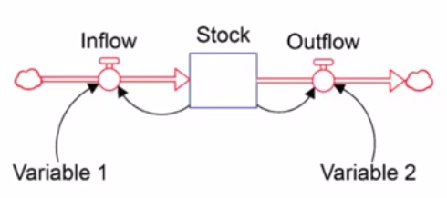
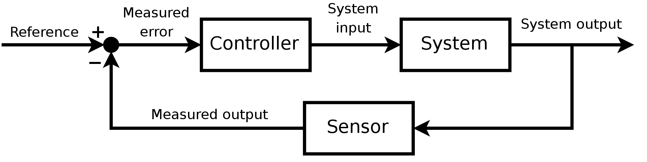
System Dynamics versus traditional control
Stock and Flow representation
States as Accumulations
Focus on Relationships
Important variables not necessarily quantified
Frequency domain analysis
Focus on Transfer Function
Control Theory
System Dynamics
States
Dynamic modelling (over time)
Polarity (Pos.&Neg.)
Feedback (Pos. & Neg.)

Slide 5
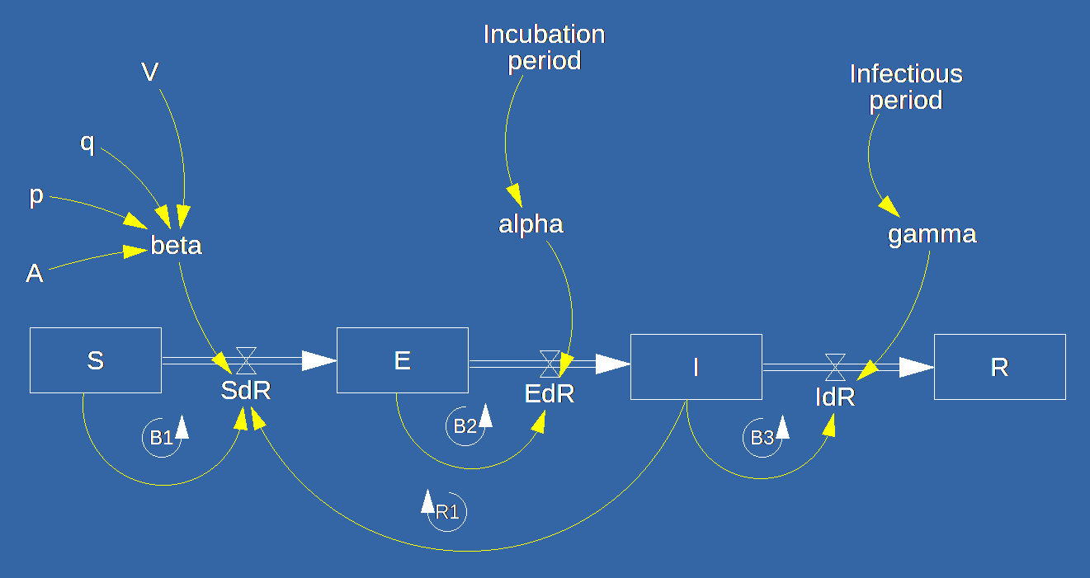
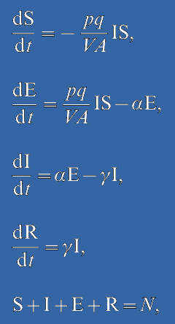
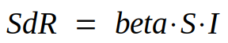
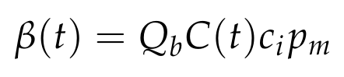
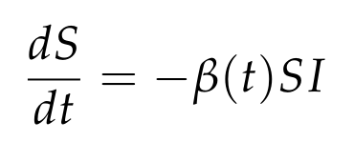
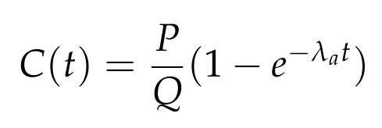
COVID-19 Model Equations
Model Source: Noakes, C.J., Beggs, C.B., Sleigh, P.A. and Kerr, K.G., 2006. Modelling the transmission of airborne infections in enclosed spaces. Epidemiology & Infection, 134(5), pp.1082-1091.

Slide 6
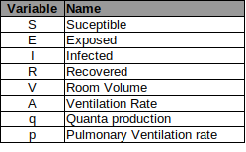
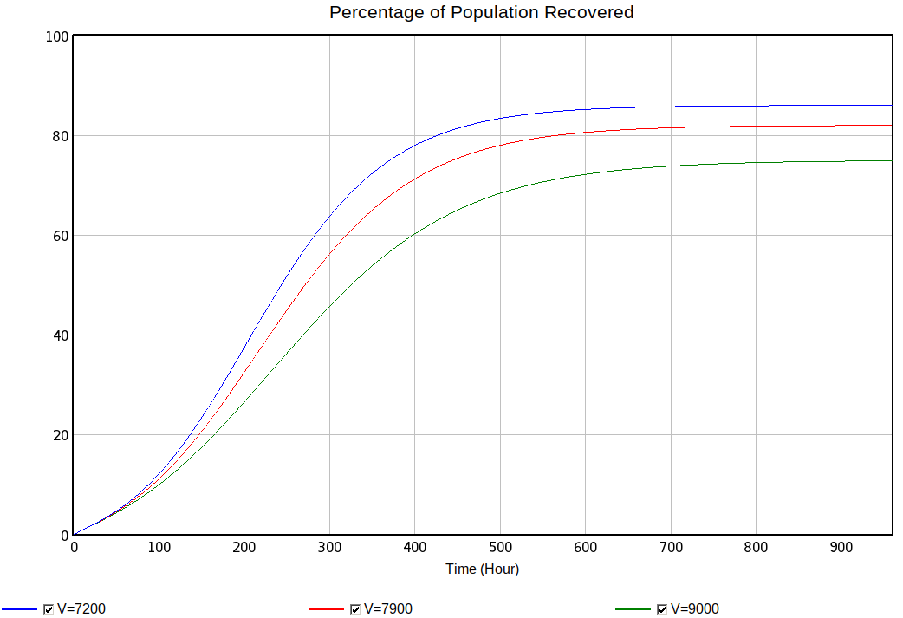
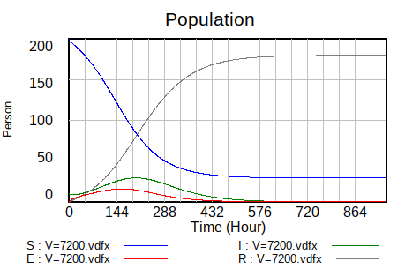
System Dynamics representation of SEIR Model
Differential Equations
Model Representation
Model Source: Noakes, C.J., Beggs, C.B., Sleigh, P.A. and Kerr, K.G., 2006. Modelling the transmission of airborne infections in enclosed spaces. Epidemiology & Infection, 134(5), pp.1082-1091.
Dynamic Simulation
Sensitivity
Phase Diagrams
SEIR dynamics
Explicit Representation of
Accumulations (Inertia)
Causal Relationships
Exogenous vs Endogenous Variables
Feedback Loop visibility (R,B)
Sensitivity Analysis:
Percentage of Population Recovered with different room Volumes, 7200, 7900 and 9000 m3

Slide 7
Application Example:
Let’s go to VENSIM
Notes:
We would like to share with describe briefly the model we have been building

Slide 8
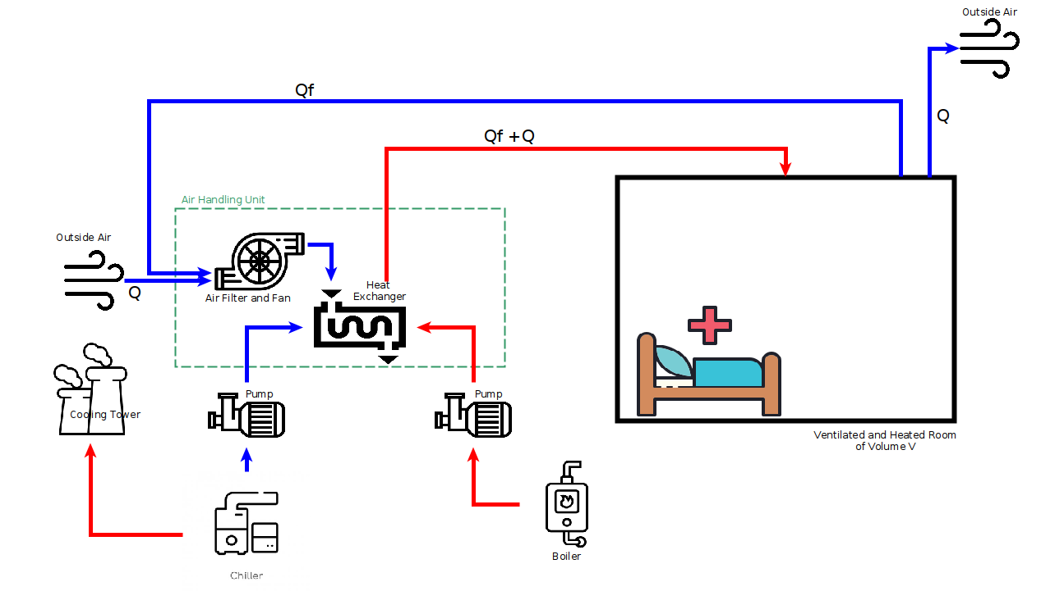


Ventilation : Simple Ventilation System
C(t)

Slide 9
Thank you
Notes:
We would like to share with describe briefly the model we have been building

Slide 10
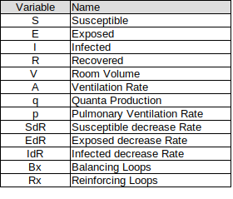
Model with all Variable names
Notes:
We would like to share with describe briefly the model we have been building

Slide 11
COMPLETE: Model with all Variable names
Notes:
We would like to share with describe briefly the model we have been building

Slide 12


Presentation
Daniel Sepulveda Estay
PhD, Operations Management, DTU
System Dynamics Modelling for:
Supply Systems
Stock fluctuations
Bullwhip effects & Hoarding
Cyber-resilience
Healthcare
Compliance Behaviour of Diabetes patients
Return patients to Emergency care
Christian Sørup
PhD, Operations Management, DTU
System Dynamics Modelling for:
Healthcare
Return patients to Emergency care
Policy analysis for COVID-19 Spread

